Slide 1


Middle East Technical University
Department of Electrical and Electronics Engineering
Development of an Integrated Modular Motor Drive (IMMD) System
Mesut Uğur
31.05.2017

Slide 2
Outline
What is IMMD?
Why IMMD?
Challenges
DC Link Capacitor Optimization
IMMD Design
Future Work

Slide 3
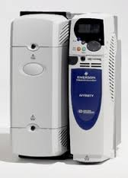
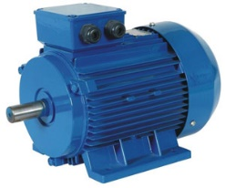
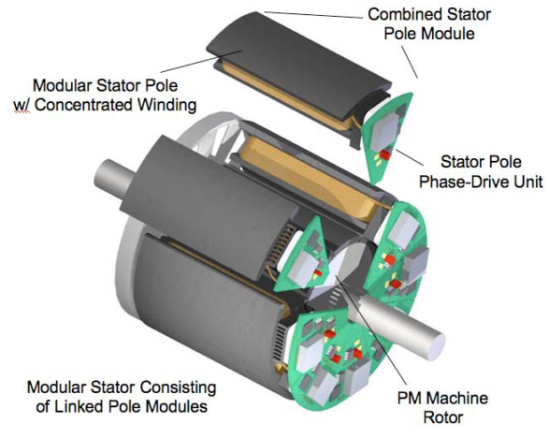
Conventional Motor Drives vs IMMD
Drives are placed in a separate cabinet
Increased volume, weight and cost
Connection with long cables
Long cable effect, EMI problems
The motor drive is integrated to the motor back-end
Both the motor and the drive are modularized

Slide 4
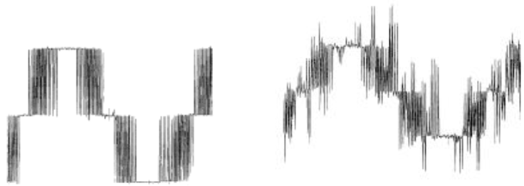
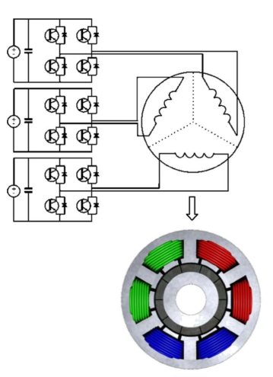
Motivation
Power density
Voltage overshoots
Motor lifetime
Increased fault tolerance
Distributed heat dissipation
Reduced voltage stress

Slide 5
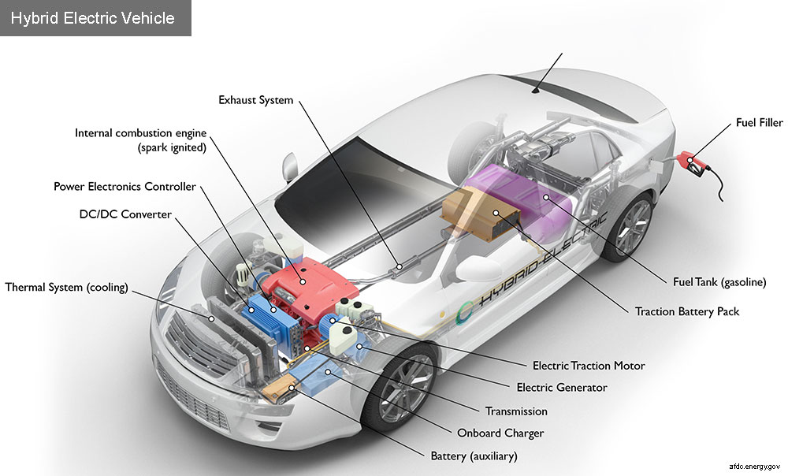
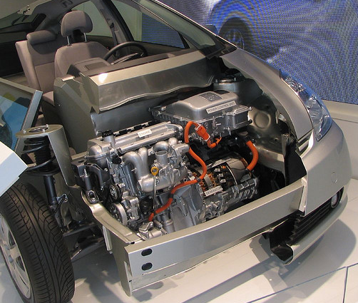
Critical Applications
Electric traction: EVs, HEVs, Trains
Aerospace: Aircrafts, Space crafts
http://www.carparts.com/classroom/alternativepowersystems.htm
https://www.afdc.energy.gov/vehicles/how-do-hybrid-electric-cars-work

Slide 6
Challenges
Small volume ?
Cooling ?
Vibration ?
Passive component size reduction
Heat sink size reduction
Achieve superior drive efficiency
Heat distribution

Slide 7
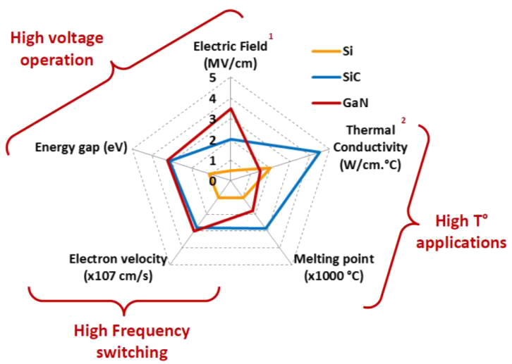
Gallium Nitride (GaN) Power Semiconductors
Wide band-gap (WBG) power semiconductor devices
Low semiconductor loss: heat sink size is reduced
High operation frequency: passive component size is reduced
The total WBG device market is expected to be $743M in 2020 in a $12.7B overall market.
https://www.slideshare.net/Yole_Developpement/sic-sapphire-gan-what-is-the-business-evolution-of-the-nonsilicon-based-semiconductor-industry-presentation-held-by-on-semicon-west-2017-by-pierric-gueguen-from-yole-dveloppement

Slide 8
DC Link Capacitor Selection
DC link capacitors constitute
20% of cost and weight
30% of volume

Slide 9
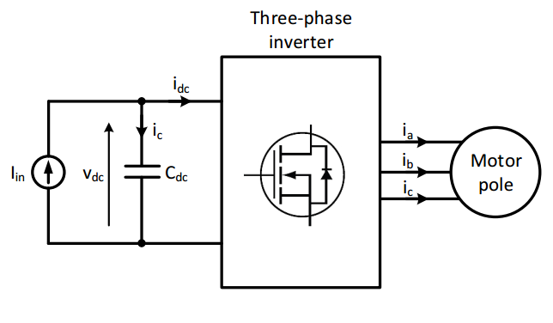
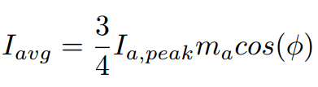

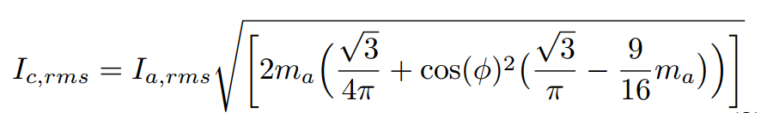
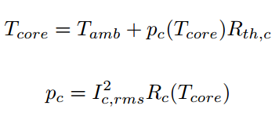
DC Link Capacitor Selection
DC Link model
Analytical model
Critical parameters
Capacitance per volume
RMS current per volume
Cost
ESL & ESR
Reliability & lifetime
Mechanical durability

Slide 10
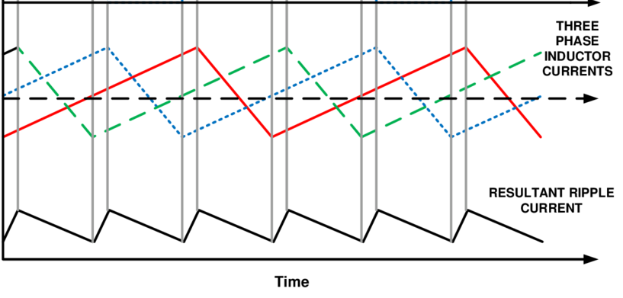
DC Link Capacitor Selection
Effect of interleaving

Slide 11
DC Link Capacitor Selection
Effect of interleaving

Slide 12
DC Link Capacitor Selection
Optimum phase shift angle for different number of modules

Slide 13
DC Link Capacitor Selection

Slide 14
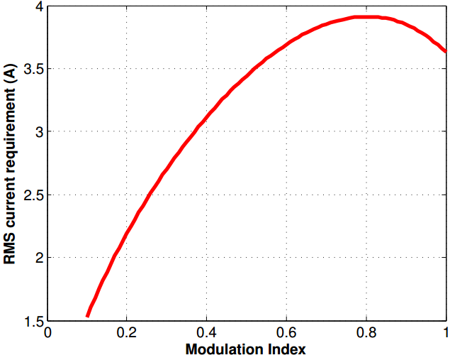
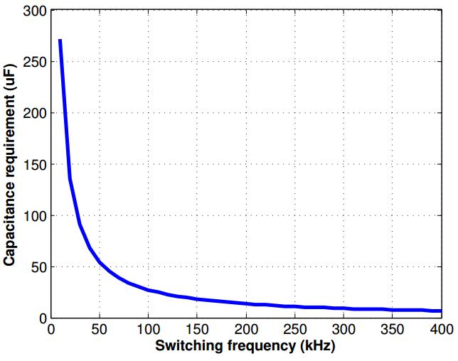
Results
RMS current vs m_{a}
Capacitance vs f_{sw}
Low voltage
Power density and cost is bad, superior thermal performance
High voltage
Low capacitance yields high cost
High capacitance yields bad thermal performance
Result:
4 25μF, 450V metal film capacitors connected in parallel

Slide 15
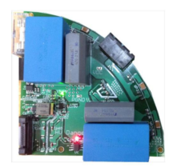
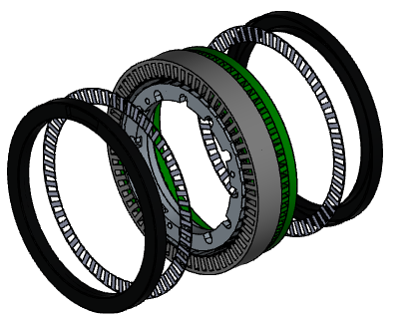
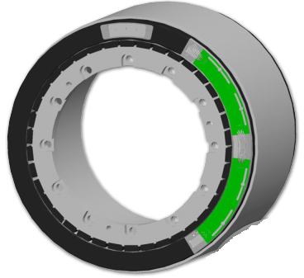
IMMD Design
Four three-phase inverter modules
Power stage with cascode GaN FETs
Permanent Magnet Brushless DC motor
Fractional Slot Concentrated Winding
Specifications
Four three-phase modules
6 kW total output power
24 slot double layer stator
20 pole PM rotor
600V – 20A GaN FETs
Four 20μF, 450V capacitors

Slide 16
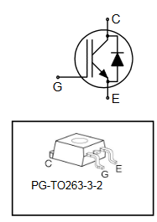
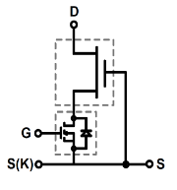
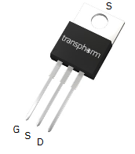
How efficient?
Loss Characterization
4 modules
P_{out} = 6 kW
IGBT: SKB15N60HS, 600V, 27A
GaN: TPH3212PS, 650V, 26A
http://www.transphormusa.com/product/tph3212ps/http://www.transphormusa.com/product/tph3212ps/

Slide 17
Future Work
Build a 6 kW laboratory prototype
Proof of concept
Drive efficiency: 98.5%
Drive power density: 15 W/cm³
Motor housing for cooling (no heatsink)
Fault tolerance tests

Slide 18
References
G. Lo Calzo et al., “Integrated motor drives: state of the art and future trends,” IET Electr. Power Appl., vol. 10, no. 8, pp. 757–771, Sep. 2016.
J. Wang, Y. Li, and Y. Han, “Integrated Modular Motor Drive Design With GaN Power FETs,” IEEE Trans. Ind. Appl., vol. 51, no. c, pp. 3198–3207, 2015.
J. J. Wolmarans, M. B. Gerber, H. Polinder, S. W. H. De Haan, J. A. Ferreira, and D. Clarenbach, “A 50kW integrated fault tolerant permanent magnet machine and motor drive,” PESC Rec. - IEEE Annu. Power Electron. Spec. Conf., pp. 345–351, 2008.
N. R. Brown, T. M. Jahns, and R. D. Lorenz, “Power Converter Design for an Integrated Modular Motor Drive,” Ind. Appl. Conf. 2007. 42nd IAS Annu. Meet. Conf. Rec. 2007 IEEE, pp. 1322–1328, 2007.
S. M. Lambert, B. C. Mecrow, R. Abebe, G. Vakil, and C. M. Johnson, “Integrated Drives for Transport - A Review of the Enabling Electronics Technology,” IEEE Veh. Power Propuls. Conf., pp. 1–6, 2015.
A. Shea and T. M. Jahns, “Hardware integration for an integrated modular motor drive including distributed control,” in 2014 IEEE Energy Conversion Congress and Exposition (ECCE), 2014, pp. 4881–4887.

Slide 19

Thank you !

Slide 20

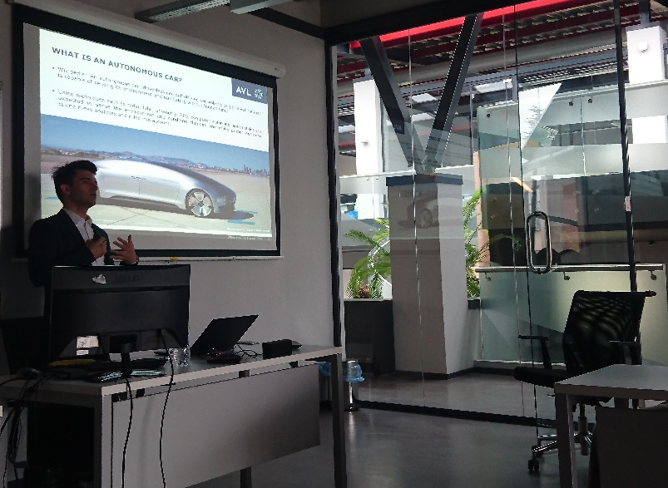
Research Group
Research Fields
Renewable Energy
Power Quality
Smart Grids
Power Electronics
Electrical Machines
http://power.eee.metu.edu.tr
Events
Weekly seminars
Journal club
Research League
EEE Star program
Undergraduate students

